Slide 1

Git: Code Collaboration
Get git right!

Slide 2

INTRODUCTION TO GIT

Slide 3
What is Git?
The most widely used modern version control system in the world today.
Git is a mature, actively maintained open source project originally developed in 2005 by Linus Torvalds, the famous creator of the Linux operating system kernel.

Slide 4
What is Version Control System?
Version control systems are a category of software tools that help a software team manage changes to source code over time.
Version control software keeps track of every modification to the code in a special kind of database.
If a mistake is made, developers can turn back the clock and compare earlier versions of the code to help fix the mistake while minimizing disruption to all team members.

Slide 5



Other Version Control System
Team Foundation Version Control (TFVC)
Subversion (SVN)
Mercurial

Slide 6
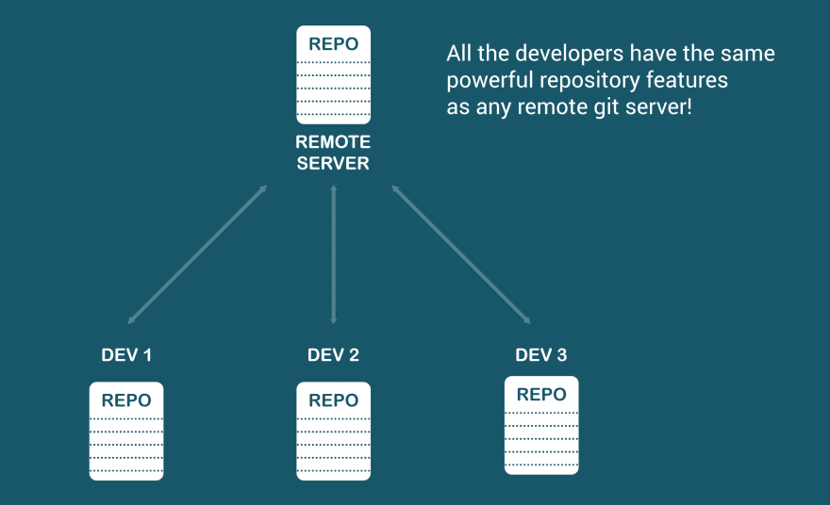
Why Git?
Git is a Distributed Version Control System.
Notes:
Git gives you a FULLY FEATURED repository on your local computer. This is different than other version control systems

Slide 7
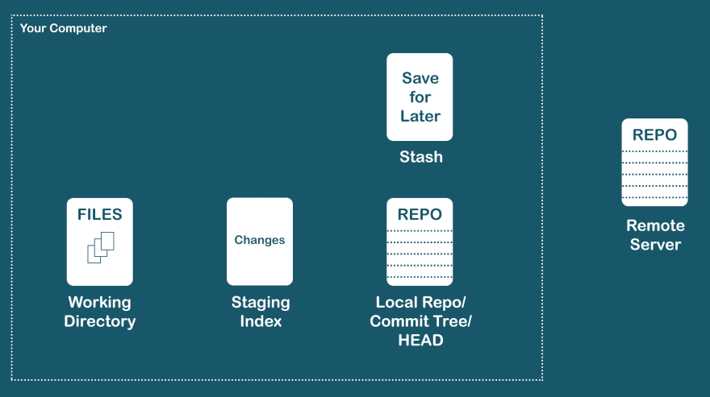
Files (and changes) location
Think of files (and changes) as being in 5 different places or “states”
GitHub
GitLab
Bitbucket
Azure

Slide 8
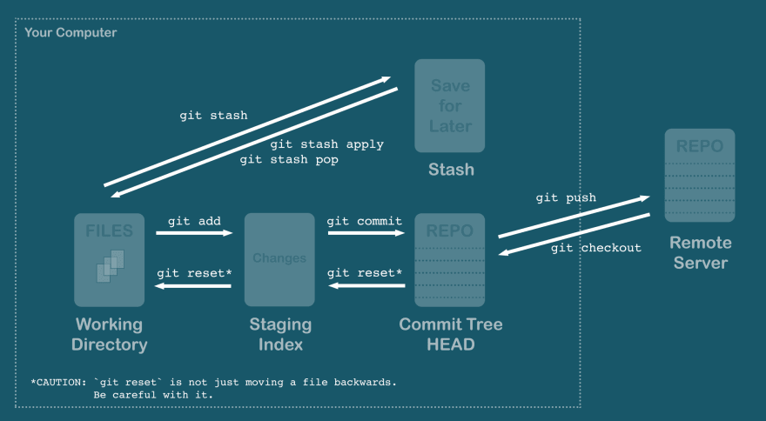
Files (and changes) flow
Think of moving files (and changes) between those places

Slide 9
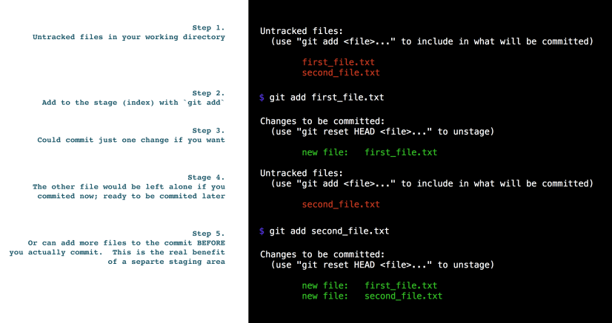
Dedicated Staging Area
Choose and review which files and changes to commit before committing

Slide 10
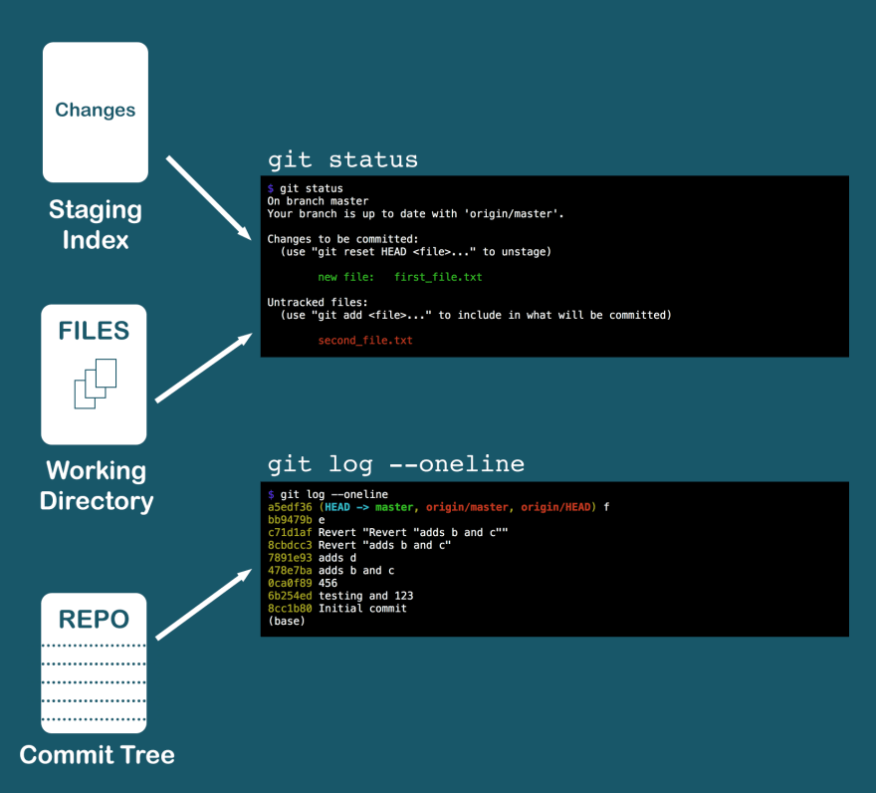
Changes now, history later
git status - shows changes in both your working directory and staging
git log - shows the history of commits on your local repository

Slide 11


GIT our hands dirty

Slide 12
SETUP DEVELOPMENT ENVIRONMENT
1. install Git for Windows
2. install Git Extensions - git GUI client
3. install KDiff3 (optional) - diff and merge tool
use to resolve conflicts
Notes:
ssh-keygen -t rsa -C "email@work_mail.com" -f "id_rsa_workuser1"
cat ~/.ssh/id_rsa_workuser1.pub | clip

Slide 13
Check your settings:
Check git version:
git --version
Check global username and email:
git config --global user.name
git config --global user.email
Set global username and email:
git config --global user.name “{username}”
git config --global user.email “{email}”

Slide 14

Remote First:
create new repository in GitHub
clone the repository to your local machine
change directory to your local repository
add a file to your local repository
stage and commit changes
push to remote repository
git clone {url}
git add {file}
git commit -m “{commit message}”
git push
Add all files:
git add .

Slide 15
git clone - clone a repository into a new directory
git add - add file content to the index
git commit - record changes to the local repository
git push - update remote refs using local refs

Slide 16
Local First:
create new local repository
add a file to your local repository
stage and commit changes
create remote repository
push to remote repository
git init
git add {file}
git commit -m “{commit message}”
git remote add origin {url}
git push -u origin master

Slide 17
git init - create an empty Git repository
or re-initialize a new one
git remote add - add a remote named {origin}
for the repository at {url}
git push -u - push to a remote and
add branch tracking reference

Slide 19
Stashing
modify a file
add a file
do a stash
modify other file
apply stash
git stash save “{message}”
git stash apply or git stash pop
git stash apply - will apply the stash
git stash pop - will apply the stash and remove it from stash list

Slide 20

2. BRANCHING AND MERGING

Slide 21
BRANCH
an independent line of development
a pointer to a snapshot of your changes
Feature A
Master
Feature B
default branch is master

Slide 22
Branch Commands
Create new branch
git branch {branch-name}
Checkout branch
git checkout {branch-name}
Create new branch and checkout
git checkout -b {branch-name}
git checkout command lets you navigate between branches

Slide 23
MERGE

Slide 24

Merge Commands
Checkout master branch
git checkout master
Merge feature branch to master branch
git merge feature
Merge manually is not recommended, instead use the merge tool in github

Slide 25
GIT our hands dirty

Slide 26
Branching:
create and checkout new branch
add or modify a file in your new branch
stage and commit changes
push to remote repository
git checkout -b new-branch
git add {file}
git commit -m “{commit message}”
git push

Slide 27
Pull Request (PR)
let you tell others about changes you’ve pushed to a branch in a repository
open for review and/or discussion about the propose changes
YOU ARE RESPONSIBLE FOR YOUR PR!

Slide 28
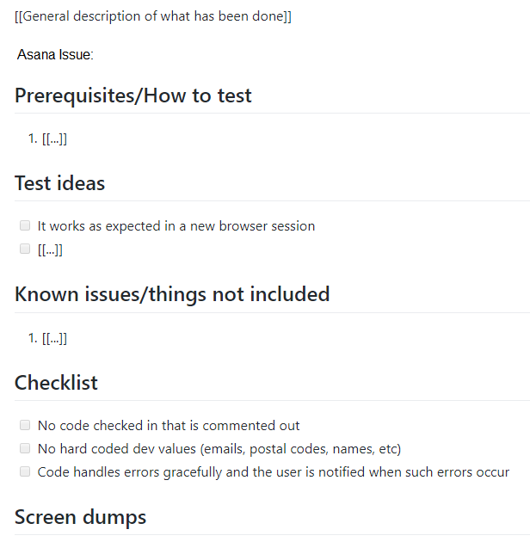
PR Template
Notes:
https://guides.github.com/features/mastering-markdown/

Slide 29
PR Review
The one reviewing should not be the same one coding
Checkout the branch
Understand all the code
Test it in your environment
Approved it if code reviewed and tested
Click merge
* If there are conflicts, talk to the author

Slide 30
3. GIT WORKFLOWS

Slide 31
GIT WORKFLOWS
recommendation for how to use Git to accomplish work in a consistent and productive manner
it depends on the team

Slide 32
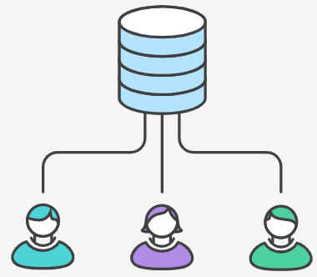
3.1 Centralized Workflow

Slide 33
Centralized Workflow
uses a central repository
all changes are committed into a single branch
hard to maintain for multiple developers
not good for hotfixes

Slide 34
3.2 Feature Branch Workflow
PR, review and merge

Slide 35
Feature Branch Workflow
branching model focused
all development should take place in a dedicated branch
all propose changes should go through pull request and reviews
huge advantage for continuous integration

Slide 36
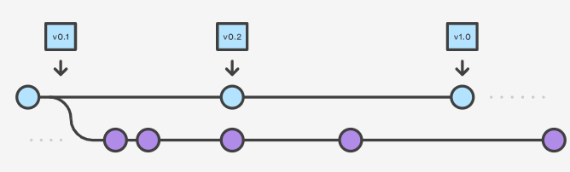
3.3 Gitflow Workflow

Slide 37
Gitflow Workflow
strict branching model
suited for projects that has scheduled release cycle
uses git-flow toolset
feature/ branch
hotfix/ branch
release/ branch
support/ branch

Slide 38
Your team, your workflow

Slide 39
GIT our hands dirty

Slide 40
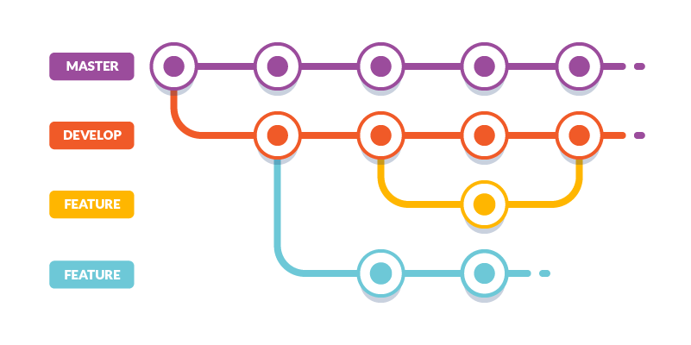
GOAL
Create branches
Commit with descriptive message
Create pull request
Review to approved pull request
Rebase branch
Resolved conflicts
Merge pull request

Slide 41
REBASE

Slide 42
How to rebase your branch:
git checkout {your-branch}
git fetch --all
git rebase origin/master
if there are conflicts, resolve it
git rebase --continue
git push --force-with-lease

Slide 43
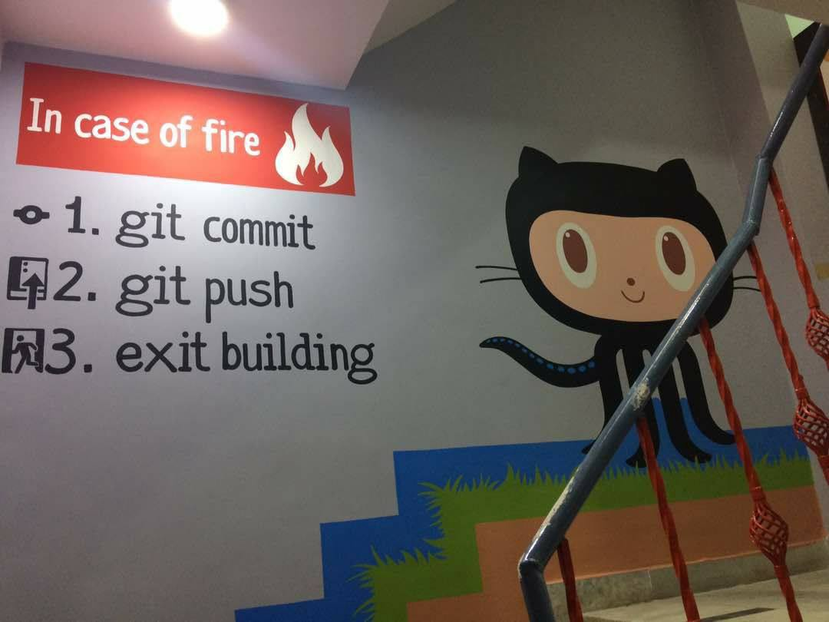
UNSURE ABOUT SOMETHING?
ASK PEOPLE!
Happy Coding!

